Slide 1
Lesson 11 – Continuous Integration

Slide 2
Lesson Goals
Development Processes
Continuous Integration
GitHub Actions
Code Quality

Slide 3
Development Processes

Slide 4
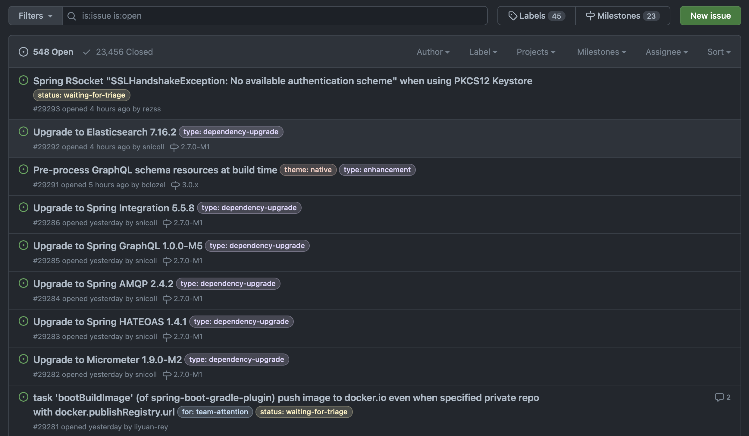
Issue Tracker (Planning, Investigating/Analyzing)

Slide 5

Development (Coding)

Slide 6
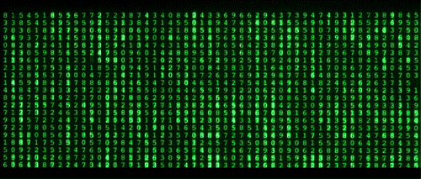
Build (Assebmle)

Slide 7
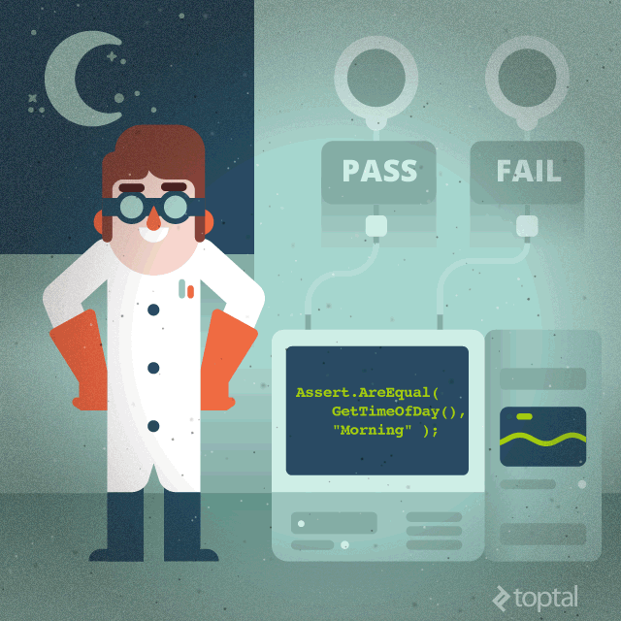
Test (Unit, Integration and other tests)

Slide 8
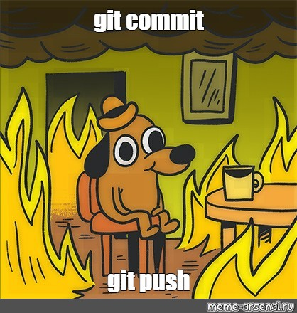
Push changes

Slide 9

Code Review

Slide 10

Quality Assurance testing in branch

Slide 11
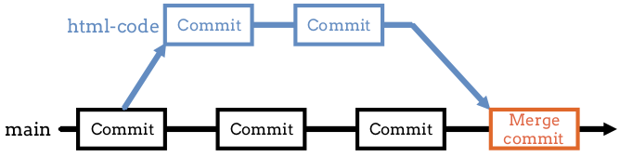
Merge changes

Slide 12
And more…
🔮 Deploy to testing servers
🧪 Quality Assurance next phases of testing
🐣 Releasing (deploy to production servers)
📈 Monitoring (server status etc)
🛠Operate (managing resources)
🤝 Support (fix bugs)

Slide 13
The problem?
🤔

Slide 14
The problem roots:
repeatable, long, boring, manual, inefficient
🔁⌛️🥱🤖💸

Slide 15
Continuous Integration

Slide 16
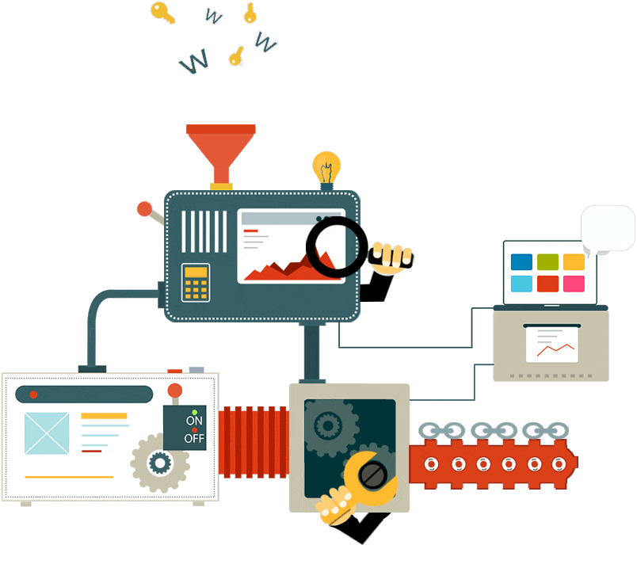
Continuous Integration

Slide 17
Continuous Integration Process
Detects errors as quickly as possible: fix problems while fresh in developers mind
Reduces integration problems: smaller problems are easier to fix
Avoid compounding problems: allows teams to develop faster, with more confidence

Slide 18
Basic CI/CD flow

Slide 19





CI/CD Tools

Slide 20


CI/CD provider for our projects

Slide 21
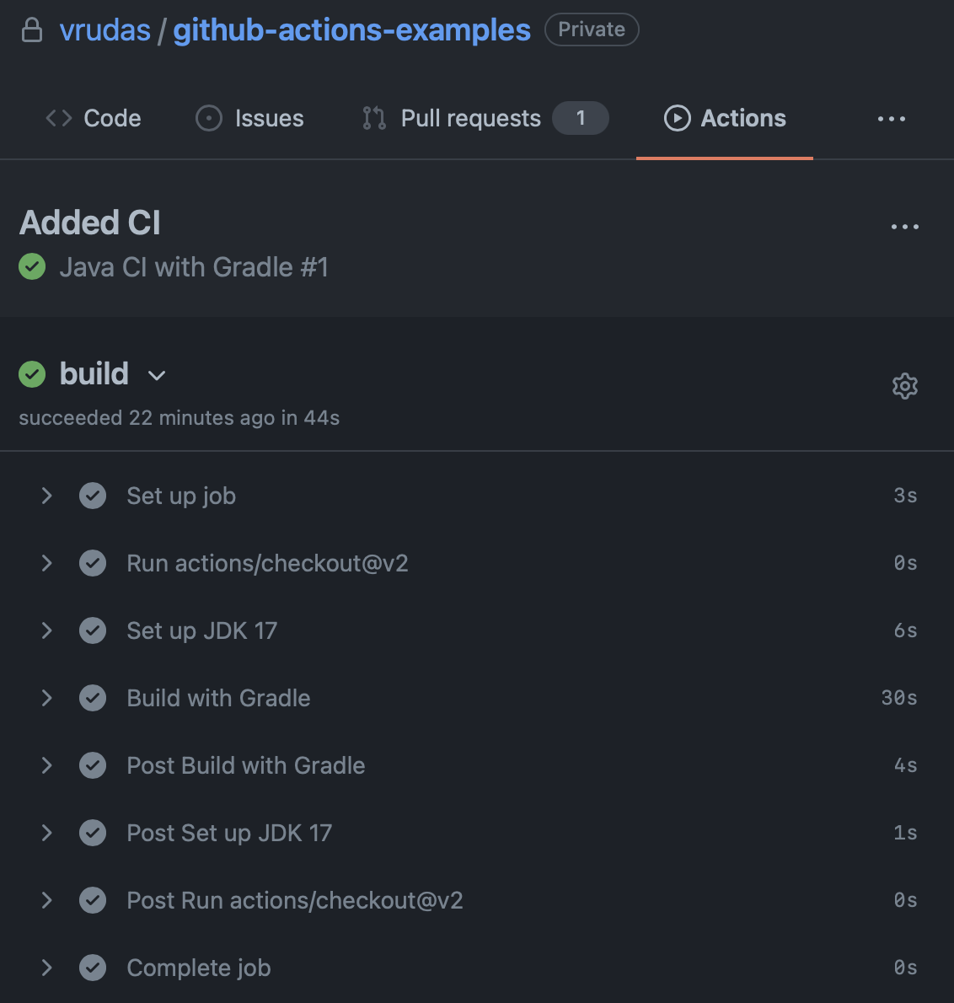
GitHub Actions - UI

Slide 22

GitHub Actions - how to configure?
Pipelines are configured using a version-controlled YAML file, in a directory:
<project_root>/.github/workflows/<name>.yml

Slide 23
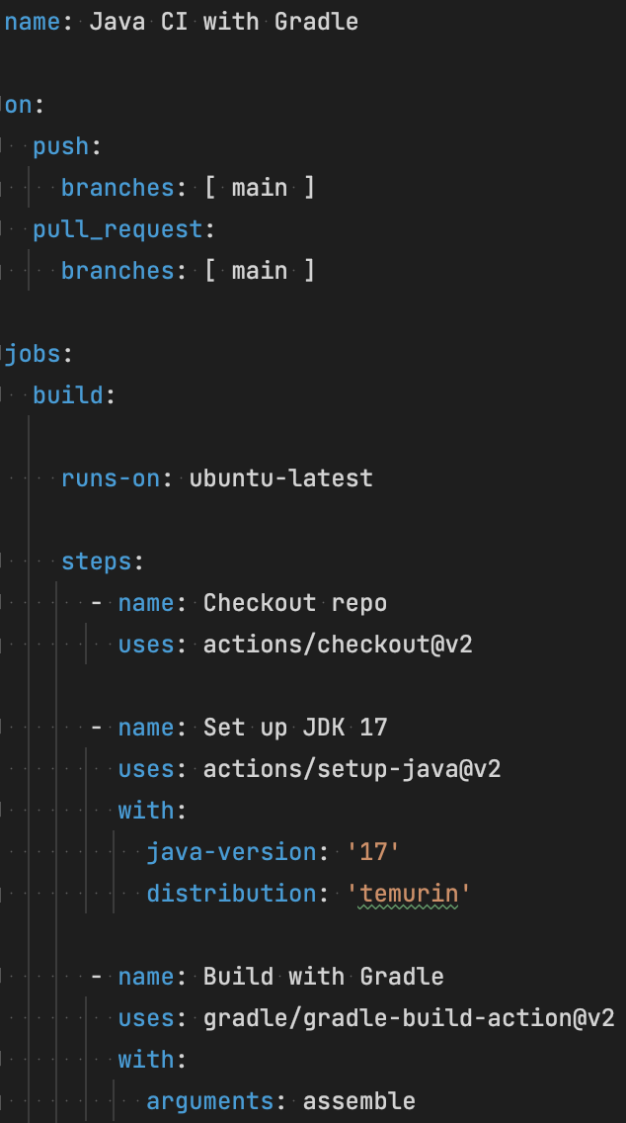
GH Actions Example:

Slide 24

Workflow file syntax

Slide 25
Additional tools

Slide 26
Code Quality

Slide 27

Dependendcy management
https://github.com/dependabot/dependabot-core

Slide 28
Summary: CI is a part of DevOps culture

Slide 29
Homework
Configure GitHub Actions for your repo
Should run on each push to main branch, and on pull request
Create Pull request when CI success
Create Pull request when CI fails
Configure CI steps:
build – only assemble project (exclude execution of tests and other verification tasks)
checkstyle – run code style checks
test – execute all tests in project

Slide 30
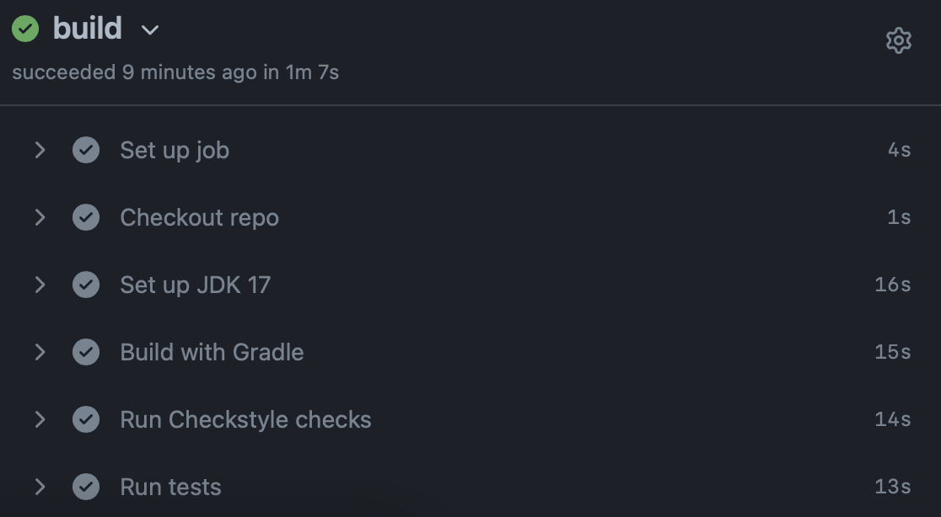
Expected CI pipeline

Slide 31
Literature
https://www.youtube.com/watch?v=R8_veQiYBjI
https://docs.github.com/en/actions/quickstart

Slide 32
Thanks!
Any Questions?
Or find us in Slack

